Slide 1


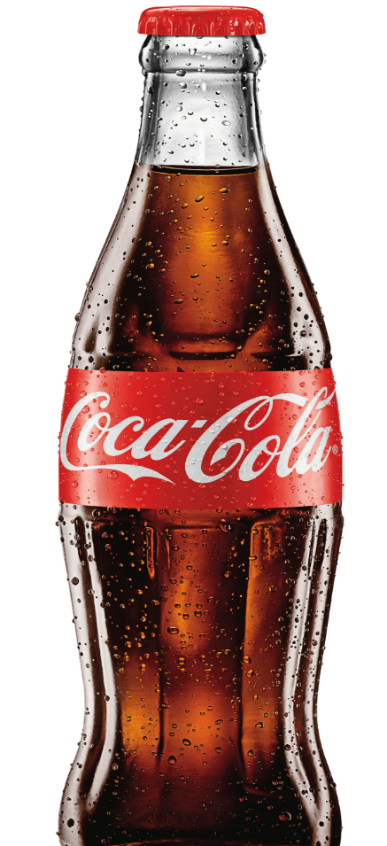
COCA-COLA
STOCK
PREDICTION
Sakshi Sanjay Dudhal
Kaustubh Arun Pasalkar
Adhoksh Milind Sonawane

Slide 2

Project Objective and Significance
Objective: Build an ARIMA model to forecast Coca-Cola's stock price trends for the next 12 months, aiding stakeholders in strategic planning.
Significance: Stock price predictions provide valuable insights for financial decision-making and investment strategies.

Slide 3





Dataset Overview
Source: Monthly Coca-Cola stock price data.
Time Period
Key Variables
Statistics
Jan 1990 - Nov 2021,
monthly observations.
Date, Open, High, Low, Close,
Adjusted Close, Volume.
Mean Close Price: $29.05, Median: $27.93, Standard Deviation: $13.11, Variance: 171.85

Slide 4


Outlier Detection
Replaced Values
Index 71 : (Value: 38.75180 )
Index 250 (Value: 55.80467)
Conclusion: Two significant outliers were detected and replaced for modeling purposes.

Slide 5
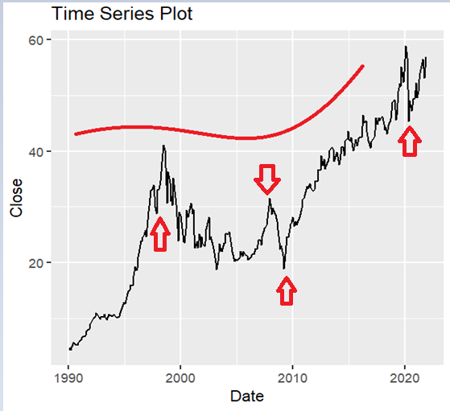
Time Series Visualization
The time series plot reveals a clear upward trend in Coca-Cola stock prices over decades. We can observe fluctuations providing insights for our analysis.
The long-term trend (red curve) suggests a steady growth in Coca-Cola's stock price, especially in recent years.
The fluctuations in the black line indicate periods of volatility, possibly due to external market or company-specific events.

Slide 6
Events that Impacted Stock Prices
Post-pandemic recovery and innovation led to an 11.40% stock rise.
Asian financial crisis limited stock gains to 1.32%.
Pandemic disrupted sales; stock rose 2.44%
due to retail demand.
Global financial crisis caused a 24.11% stock decline
Recovery efforts drove
a 30.24% stock increase.
1998
2021
2020
2008
2009

Slide 7
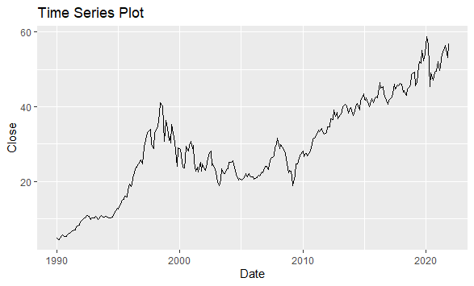


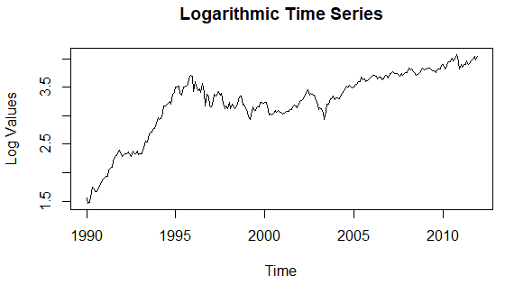

Logarithmic Transformation
Raw Data
Original stock prices with varying volatility.
Before
Log Transformation
Applied to stabilize variance for better modeling.
Results
After
Clearer trends revealed, preparing data for stationarity analysis.

Slide 8
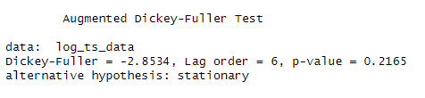
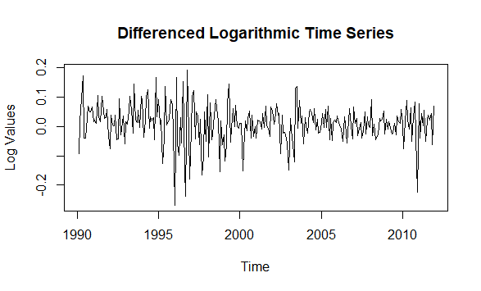
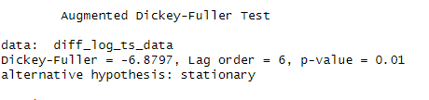
Stationarity Analysis
1
Augmented Dickey-Fuller Test
Log Data: p-value = 0.2165 (Non-stationary)
2
First-Order Differencing
Applied to achieve stationarity
3
ADF Test on Differenced Data
p-value = 0.01 (Stationary)

Slide 9
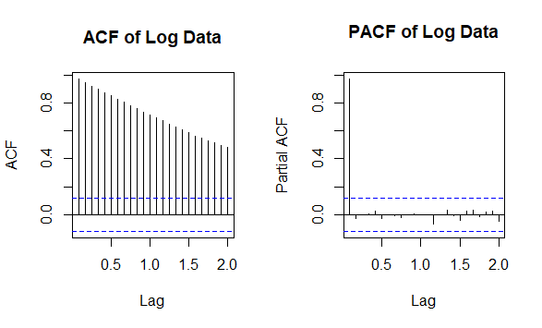
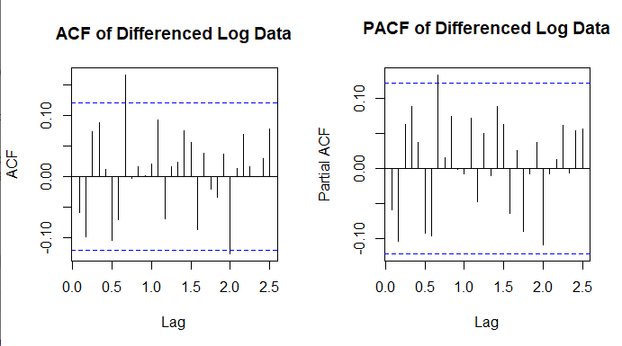
Stationarity Analysis
Before Differencing
After Differencing
This confirms the effectiveness of the first-order differencing in achieving stationarity.
The resulting clearer trends and stationarity in the data allow for more accurate and reliable modeling and analysis

Slide 10
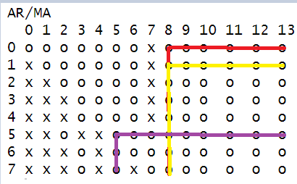
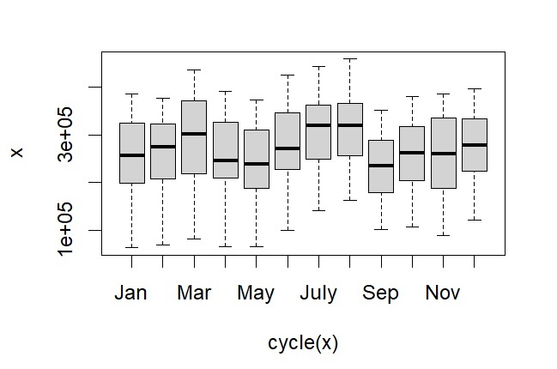
Model Selection
Box Plot
ARIMA(0,1,1)
ARIMA(5,1,5)
ARIMA(1,1,8)
Final models based on EACF graph and ACF PACF

Slide 11
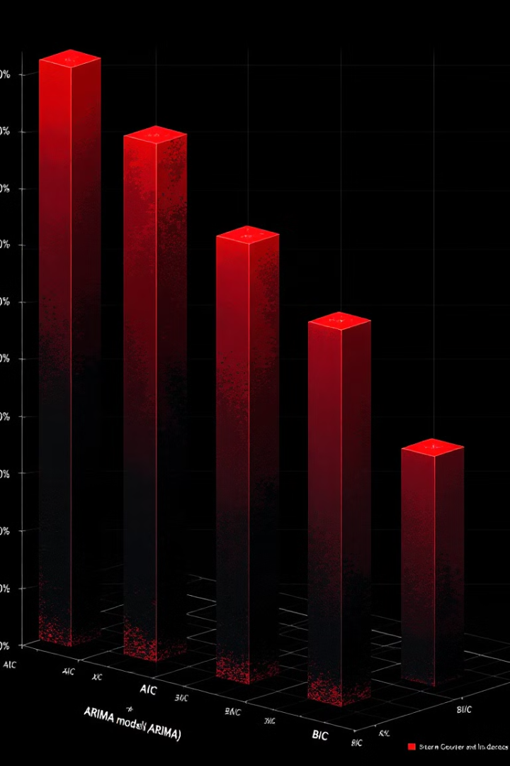
ARIMA Model Selection
Model
AIC
BIC
ARIMA(0,1,1)
-671.07
-661.93
ARIMA(1,1,8)
-672.17
-634.48
ARIMA(5,1,5)
-673.67
-638.42
ARIMA(5,1,5) outperforms others with the lowest AIC and BIC values, indicating the best fit for our data.

Slide 12
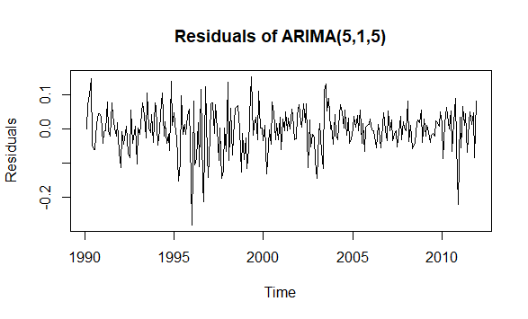
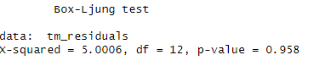
Model Diagnostics
Residual Analysis
Box-Ljung Test
Residual plots show no significant patterns, indicating a good model fit.
p-value > 0.05, suggesting no significant autocorrelation in residuals.
White Noise
Residuals exhibit characteristics of white noise, validating the model.

Slide 13
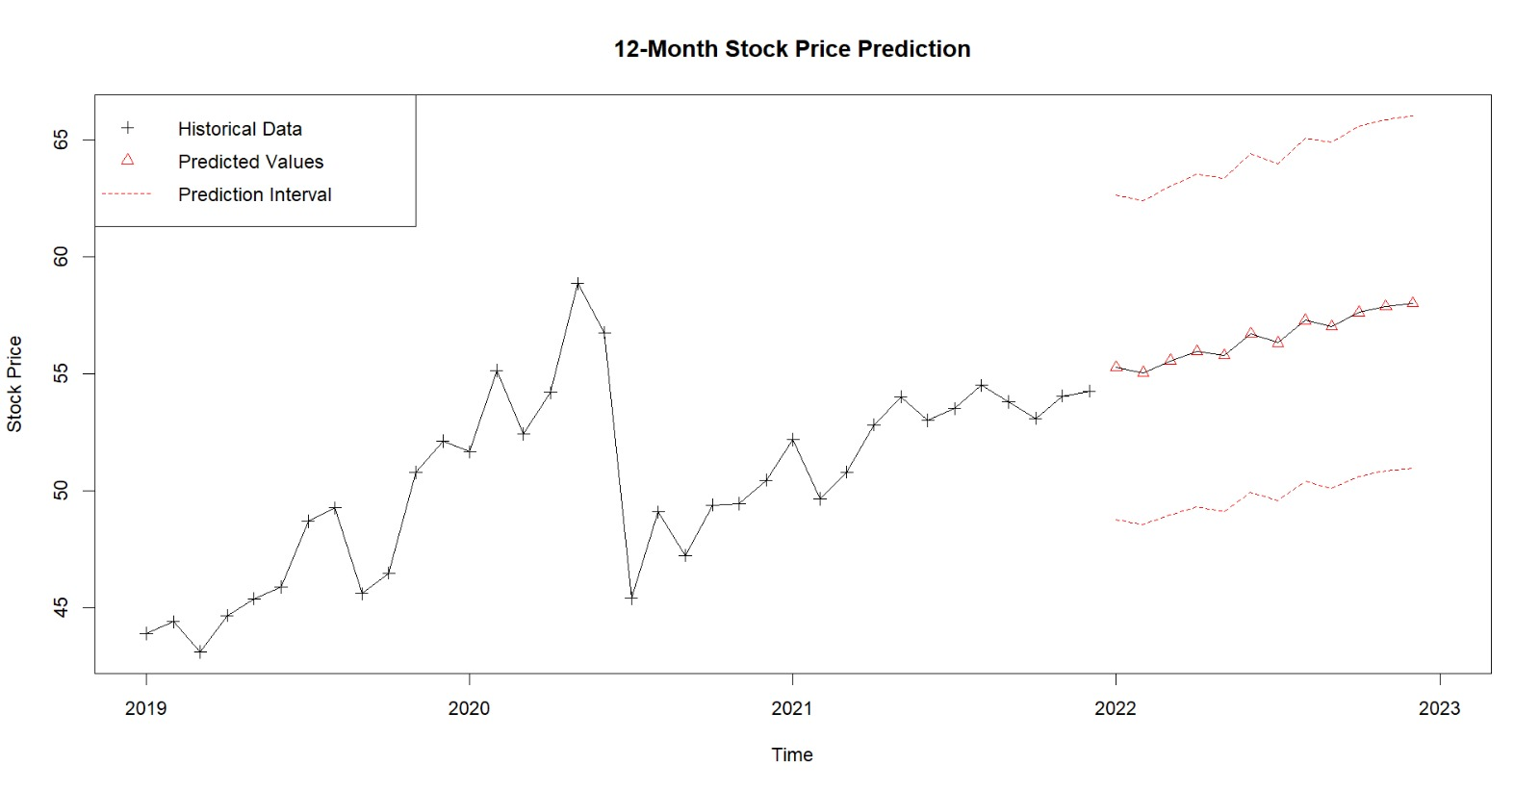
12-Month Stock Price Forecast

Slide 14
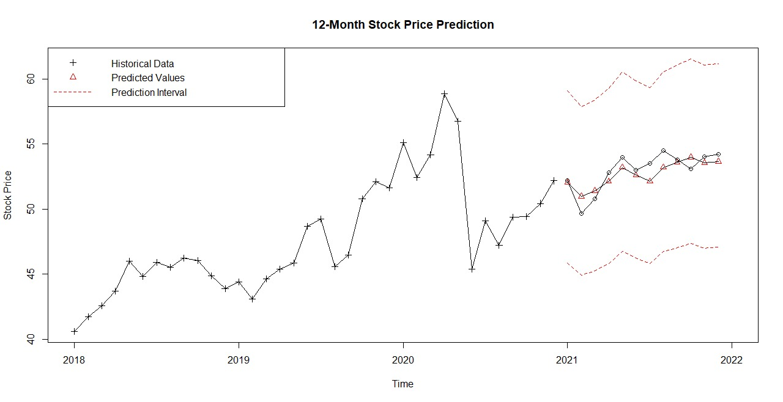
Why our forecasting is correct?

Slide 15




Why Do We Need This Forecasting?
Informed Investment Decisions
1
Helps investors decide when to buy, sell, or hold Coca-Cola stock.
Risk Management
2
Mitigates risks by identifying market trends and seasonal fluctuations
Strategic Financial Planning
3
Supports budgeting, setting benchmarks, and aligning
strategies with market dynamics.
Economic Insights
4
Reflects broader economic and industry trends for
policymakers and analysts

Slide 16

Conclusion and Future Scope
1
Effective Modeling
ARIMA(5,1,5) successfully captures Coca-Cola stock price trends.
12
Month Forecast
Provides actionable insights for financial planning and investment strategies.
∞
Future Possibilities
Explore external variables like economic indicators for enhanced accuracy.

Slide 17
References:
1.The Coca-Cola Company. (2024, October 30). Coca-Cola reports third quarter 2024 results
and provides outlook for the full year. Coca-Cola. https://shorturl.at/bYJFM
2. SlideEgg. (n.d.). Create stunning PowerPoint slides with our templates.
SlideEgg. https://www.slideegg.com
3. Yahoo Finance. (n.d.). Coca-Cola (KO) historical data. Yahoo Finance.
https://shorturl.at/Sjbm5

Slide 18
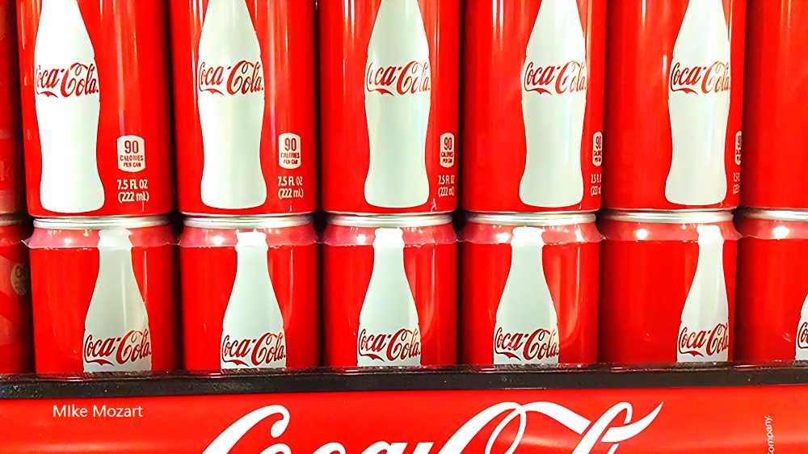
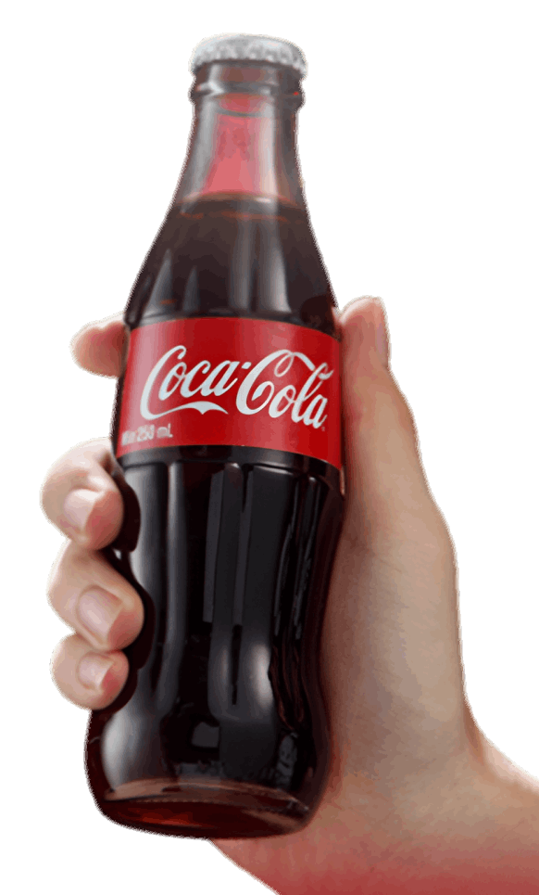
THANK YOU….

